Slide 1
La duplicación de ADN
AGATA CAVIGIOLI
FRANCESCA BARI

Slide 2
def animation_complete(DNA_sequence_complete,PAUSE = 0.15):
ROWS = [
' #{}-{}#',
' #{}---{}#',
' #{}-----{}#',
' #{}------{}#',
' #{}------{}#',
' #{}-----{}#',
' #{}---{}#',
' #{}-{}#',
' #{}-{}#',
' #{}---{}#',
' #{}-----{}#',
' #{}------{}#',
' #{}------{}#',
' #{}-----{}#',
' #{}---{}#',
' #{}-{}#']
time.sleep(2)
rowIndex = 0
for row_index, row in enumerate(DNA_sequence_complete):
rowIndex = rowIndex + 1
if rowIndex == len(ROWS):
rowIndex = 0
if rowIndex in range(8):
leftNucleotide, rightNucleotide = row[0], row[1]
else:
leftNucleotide, rightNucleotide = row[1], row[0]
print(ROWS[rowIndex].format(leftNucleotide, rightNucleotide))
time.sleep(PAUSE) # Add a slight pause.
def animation_partial(DNA_half1,DNA_half2,PAUSE = 0.15):
ROWS = [
' #{} {}#',
' #{} {}#',
' #{} {}#',
' #{} {}#',
' #{} {}#',
' #{} {}#',
' #{} {}#',
' #{} {}#',
' {}# #{}',
' {}# #{}',
' {}# #{}',
' {}# #{}',
' {}# #{}',
' {}# #{}',
' {}# #{}',
' {}# #{}']
time.sleep(2)
rowIndex = 0
for row_index, row in enumerate(DNA_half1):
rowIndex = rowIndex + 1
if rowIndex == len(ROWS):
rowIndex = 0
if rowIndex in range(8):
leftNucleotide, rightNucleotide = DNA_half1[row_index], DNA_half2[row_index]
else:
leftNucleotide, rightNucleotide = DNA_half2[row_index], DNA_half1[row_index]
print(ROWS[rowIndex].format(leftNucleotide, rightNucleotide))
time.sleep(PAUSE) # Add a slight pause.
El código comienza con dos funciones que permitirán al programa imprimir ADN en animación.

Slide 3
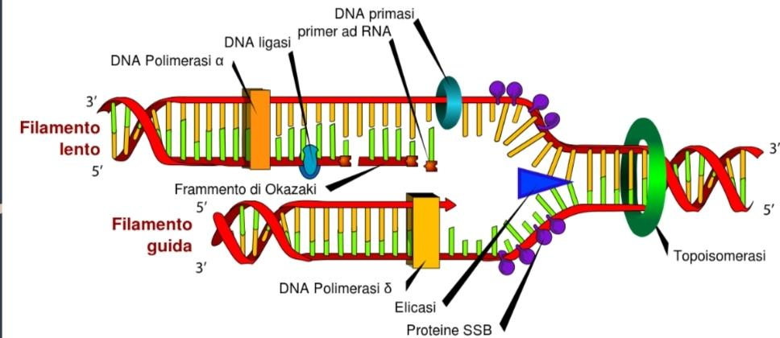
Inserción
import random, sys, time
class DNA:
def __init__(self, length, name):
DNA_bases = ['A', 'T', 'C', 'G']
start_sequence = 'TAC' # Start codon
stop_sequences = ['ATT', 'ATC', 'ACT']
random_stop_sequence = random.choice(stop_sequences)
random_sequence = ''.join(random.choice(DNA_bases) for _ in range(length-6))
seq = start_sequence + random_sequence + random_stop_sequence
DNA_sequence_complete = [['' for _ in range(2)] for _ in range(length)]
conversion_dict1 = {'A': 'T', 'T': 'A', 'C': 'G', 'G': 'C'}
i = 0
for base in seq:
opp_base = conversion_dict1[base]
DNA_sequence_complete[i][0] = base
DNA_sequence_complete[i][1] = opp_base
i+=1
self.seq = DNA_sequence_complete #set the sequence
self.name = name #set the name
def set_name (self, name):
self.name = name
def get_name (self):
return self.name
def set_seq (self, seq):
self.seq = seq
def get_seq (self):
return self.seq
DNA1 = DNA(50, 'dna1')
print("DNA Sequence Complete:", DNA1.get_seq())
animation_complete(DNA1.get_seq(),PAUSE = 0.10)
La replicación del ADN comienza con una proteína: la helicasa.
Esta proteína dividirá los puentes de hidrógeno entre las bases nitrogenadas. En este punto interviene la ADN polimerasa III que copiará las bases nitrogenadas de 5' a 3’.
La segunda cadena (dna2) se replicará con fragmentos de Okazaki.

Slide 4
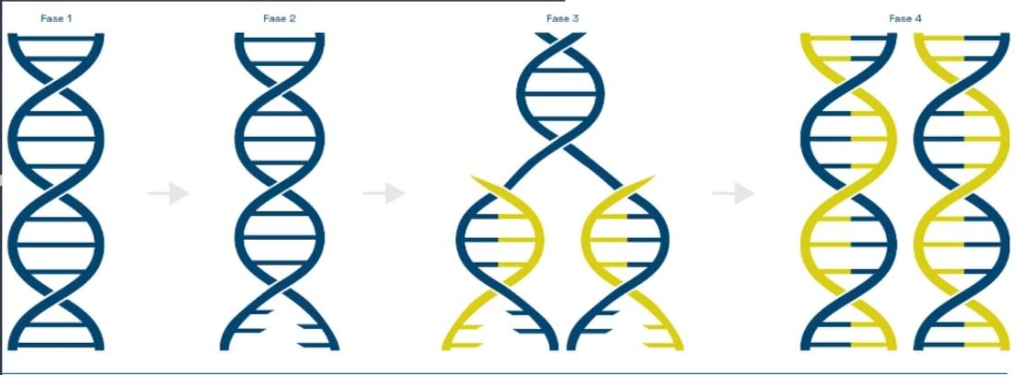
def split_DNA(DNA_sequence_complete):
column = [row[0] for row in DNA_sequence_complete]
DNA_half1 = ''.join(column)
column = [row[1] for row in DNA_sequence_complete]
DNA_half2 = ''.join(column)
return DNA_half1,DNA_half2
DNA_half1,DNA_half2 = split_DNA(DNA1.get_seq())
print('First DNA strand:',DNA_half1)
print('Second DNA strand:',DNA_half2)
animation_partial(DNA_half1,DNA_half2,PAUSE = 0.05)
def DNAComplementare(DNA_half):
DNA_sequence = [['' for _ in range(2)] for _ in range(len(DNA_half))]
conversion_dict1 = {'A': 'T', 'T': 'A', 'C': 'G', 'G': 'C’}
i = 0
for base in DNA_half:
opp_base = conversion_dict1[base]
DNA_sequence[i][0] = base
DNA_sequence[i][1] = opp_base
i+=1
return DNA_sequence
DNA_replicated1 = DNAComplementare(DNA_half1)
print('First replicated DNA:', DNA_replicated1)
animation_complete(DNA1.get_seq(),PAUSE = 0)
DNA_replicated2 = DNAComplementare(DNA_half2)
print('Second replicated DNA:', DNA_replicated2)
animation_complete(DNA1.get_seq(),PAUSE = 0)
La ADN polimerasa duplica el primer segmento linealmente. El segundo segmento se duplica más lentamente. Al final la topoisomerase va a juntar Las dos cadenas de ADN y va a poner los puentes de hidrógeno entre las bases azotes.
La replicación del ADN puede ser conservativo, semiconservativo y dispersivo.
Esto es semiconservativo.

Slide 5
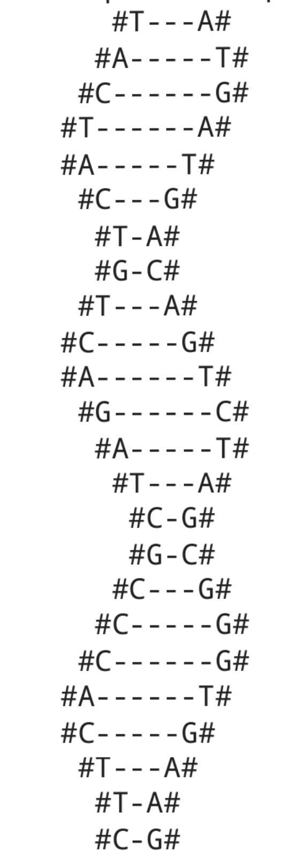
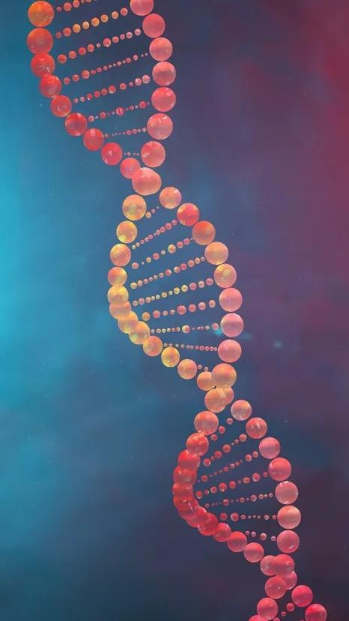
Output final:
First DNA strand: TACTACTCAGTCTAGGCCCACTTG
Second DNA strand: ATGATGAGTCAGATCCGGGTGAAC

